Slide 1

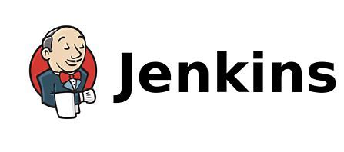

Slide 2
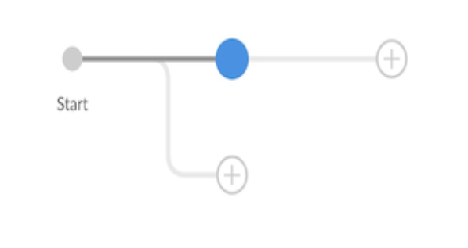
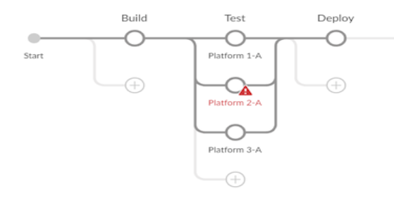
Stage editor
Stages can be added to the Pipeline by clicking the "+" button to the right of an existing stage.
Parallel stages can be added by clicking the "\+" button below an existing Stage. Stages can be deleted using the context menu in the stage configuration sheet.
The Stage editor will display the name of each Stage once it has been set.
Stages that contain incomplete or invalid information will display a warning symbol.
Pipelines can have validation errors while they are being edited, but cannot be saved until the errors are fixed.

Slide 3
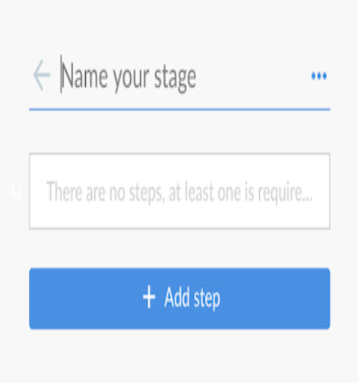
Stage configuration
Selecting a stage in the Stage editor will open the "Stage Configuration" sheet on the right side.
Here we can change the name of the Stage, delete the Stage, and add steps to the Stage.
The name of the Stage can be set at the top of the Stage Configuration sheet.
The context menu (three dots on the upper right), can be used to delete the current stage.
Clicking "Add step" will display the list of available Steps types with a search bar at the top.
Steps can be deleted using the context menu in the step configuration sheet.
Adding a step or selecting an existing step will open the step configuration sheet.

Slide 4
Step configuration
Selecting a step from the Stage configuration sheet will open the Step Configuration sheet.
This sheet will differ depending on the step type, containing whatever fields or controls are needed. The name of the Step cannot be changed. The context menu (three dots on the upper right), can be used to delete the current step.
Fields that contain incomplete or invalid information will display a warning symbol. Pipelines can have validation errors while they are being edited, but cannot be saved until the errors are fixed.

Slide 5
Save Pipeline dialog
In order to be run, changes to a Pipeline must be saved in source control The "Save Pipeline" dialog controls saving of changes to source control.
A helpful description of the changes can be added or left blank.
The dialog also supports saving changes the same branch or entering a new branch to save to.
Clicking on "Save & run" will save any changes to the Pipeline as a new commit, will start a new Pipeline Run based on those changes, and will navigate to the Activity View for this pipeline.

Slide 6
Managing Jenkins
This chapter cover how to manage and configure Jenkins masters and nodes.
This chapter is intended for Jenkins administrators. More experienced users may find this information useful, but only to the extent that they will understand what is and is not possible for administrators to do.
Individual sections may assume knowledge of information from previous sections, but such assumptions will be explicitly called out and cross-referenced.
Helpful Documents for getting knowledge about Jenkins:
Getting Started with Jenkins.
Using Jenkins
Jenkins System Administration

Slide 7
Configuring the System
As a Jenkins admin, Configure System(Option to configure Jenkins settings) is the most prominent section of Jenkins.
Here, the admin can define global settings that apply to all the projects that are present in Jenkins. Now, the question is how to navigate towards the Configure System option in Jenkins.
Subsequently, to navigate to the Configure System option, kindly follow the below steps:

Slide 8
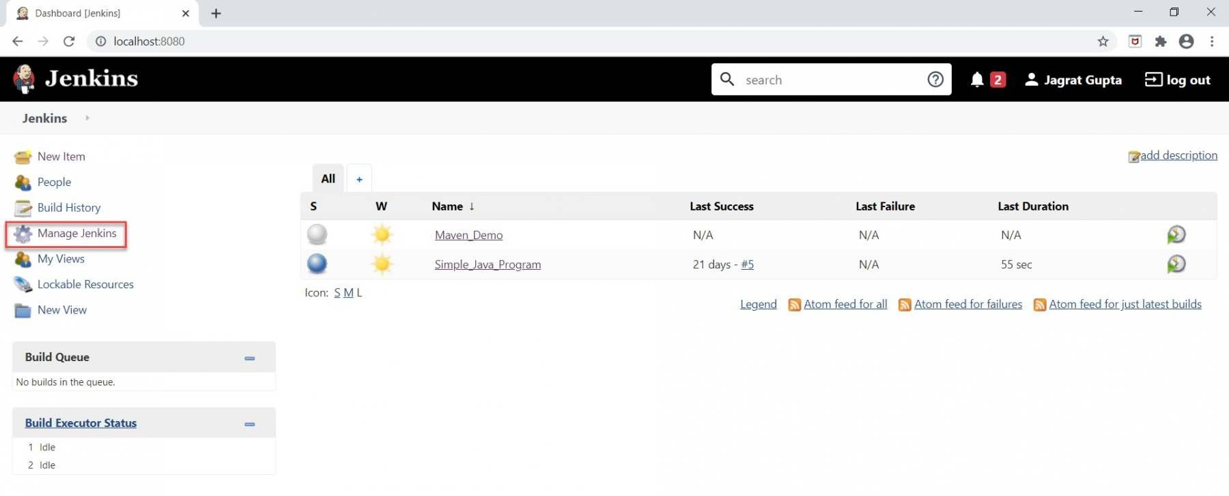
Step 1: Navigate to the Jenkins dashboard and after that, click on the "Manage Jenkins " option highlighted below:

Slide 9
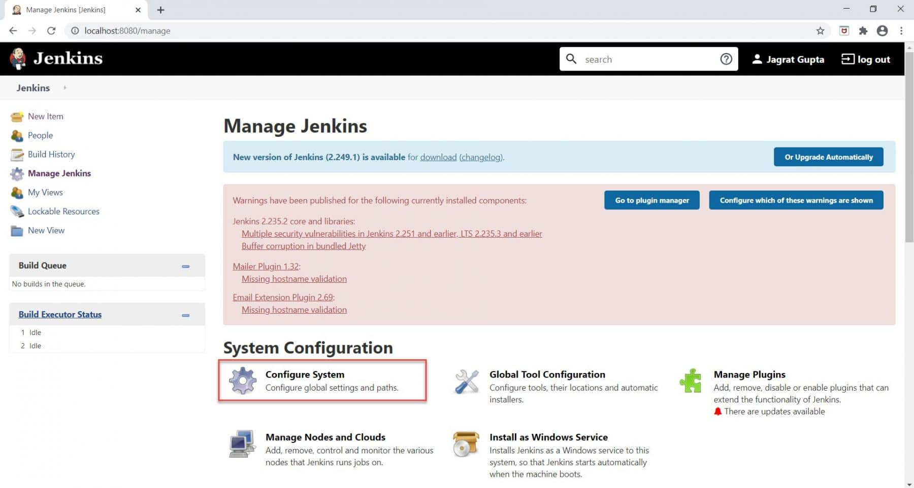
Step 2: As soon as we will click on the "Manage Jenkins" option, we will be redirected to the "Manage Jenkins" page. Here, we need to click on "Configure System " highlighted in red under the "System Configuration" section.

Slide 10
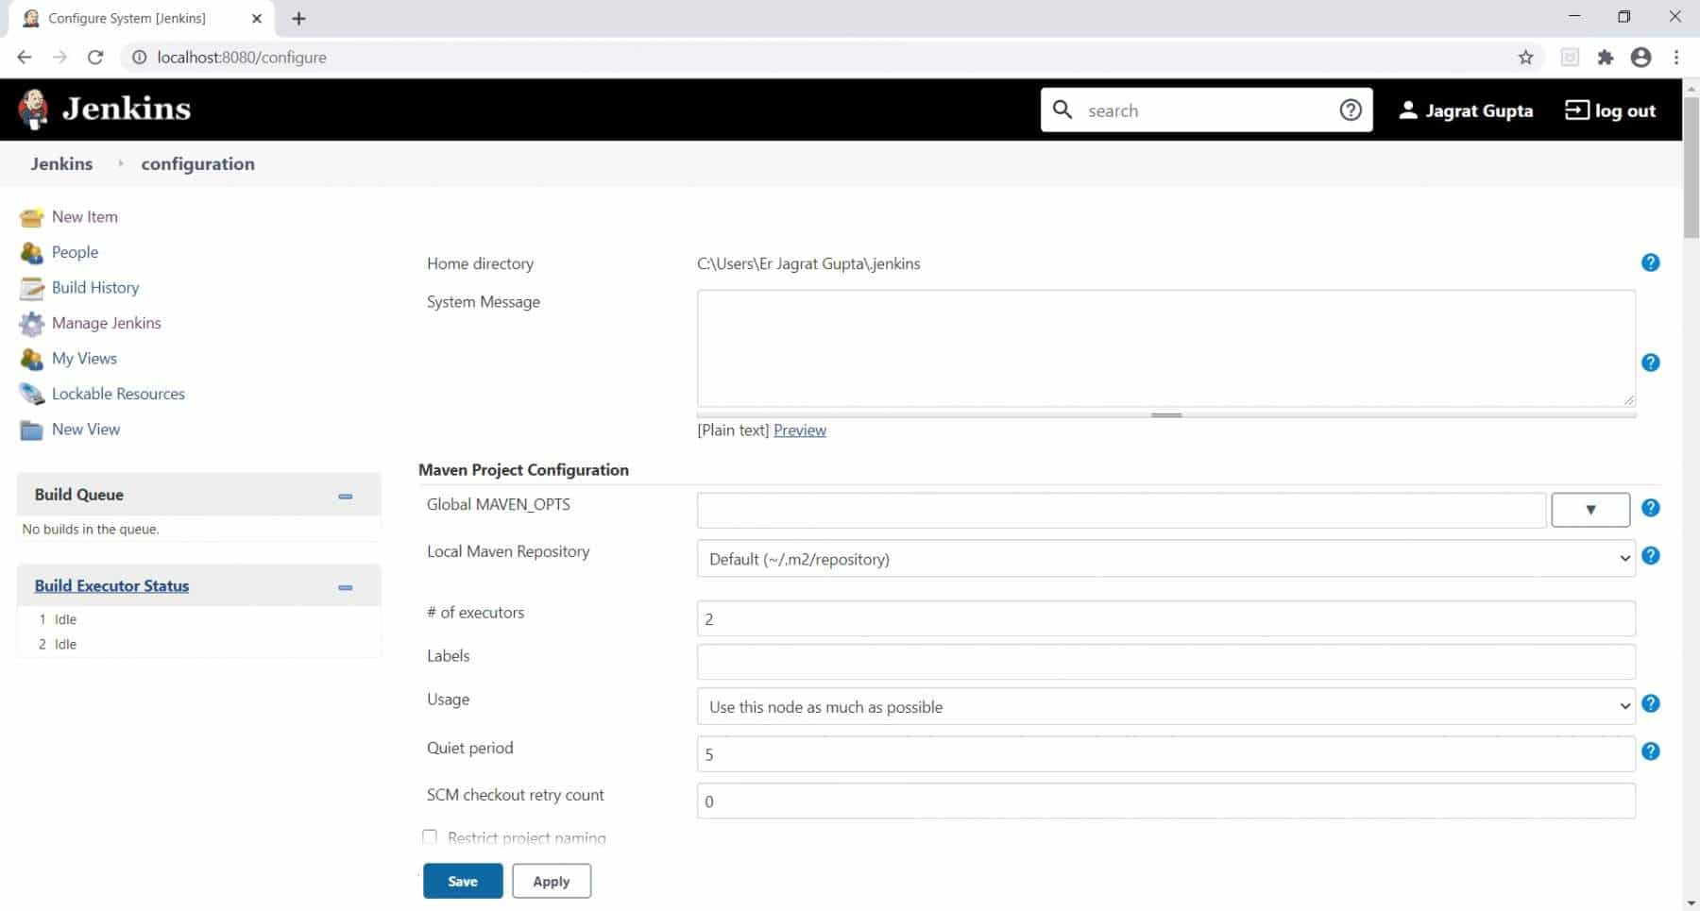
Step 3: We will click on the Configure System link. Subsequently, we will go to the configuration page as displayed below:

Slide 11
Option | Description
Jenkins home directory | This attribute tells us the placement of our home directory of Jenkins in the system.
System Message | A system message displays the messages on the Jenkins dashboard page.
Executors | This configuration option tells us that how many parallel jobs can be run at the Jenkins machine.
Usage option | This option tells us that how Jenkins schedules build on any node.
Quiet period | When this option is non-zero, newly triggered builds of this project will be added to the queue, but Jenkins will wait for the specified period of time (in seconds ) before actually starting the build.
Jenkins URL | This option, by default, depicts the HTTP address of Jenkins installation in the form of localhost. We can write DNS (Domain Name ) of our machine or overwrite the localhost with the IP address of the machine.
Environment variable | Environment variables apply for every build on every node. They can be used in Jenkins' configuration (*as $key or ${key} *) and will be added to the environment for processes launched from the build.
Usage statistics | This option is used to track usage data in Jenkins.
Git Plugin | This option is used to set global git username and email details in Jenkins.
Email notification | This option is used to configure email related configurations to send email regarding build result after running builds.

Slide 12
Managing Security
Jenkins is used everywhere from workstations on corporate intranets, to high-powered servers connected to the public internet. To safely support this wide spread of security and threat profiles, Jenkins offers many configuration options for enabling, editing, or disabling various security features.
As of Jenkins 2.0, many of the security options were enabled by default to ensure that Jenkins environments remained secure unless an administrator explicitly disabled certain protections.
This section will introduce the various security options available to a Jenkins administrator, explaining the protections offered, and trade-offs to disabling some of them.

Slide 13
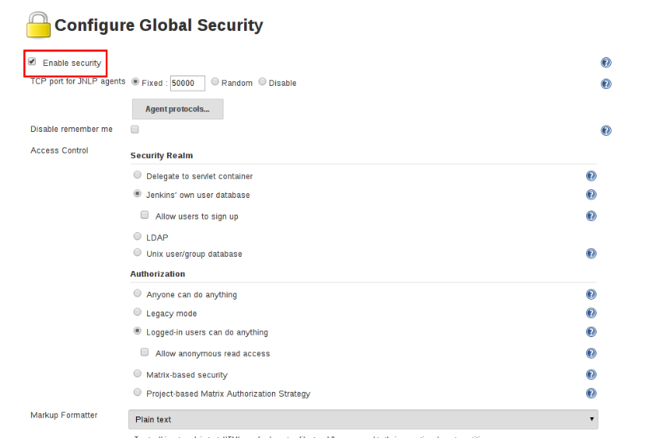
Enabling security
From the second version of jenkins, the enable security checkbox can be checked

Slide 14
JNLP TCP Port Jenkins uses a TCP port to communicate with agents launched via the JNLP protocol, such as Windows-based agents. Port options: 1. Random: The JNLP port is chosen randomly to avoid collisions on the Jenkins master. The downside to randomized JNLP ports is that they’re chosen during the boot of the Jenkins master, making it difficult to manage firewall rules allowing JNLP traffic. 2. Fixed: The JNLP port is chosen by the Jenkins administrator and is consistent across reboots of the jenkins master. This makes it easier to manage firewall rules allowing JNLP-based agents to connect to the master.

Slide 15
Access Control Access Control is the primary mechanism for securing a Jenkins environment against unauthorized usage. 1. A Security Realm which informs the Jenkins environment how and where to pull user (or identity) information from. Also commonly known as "authentication." 2. Authorization configuration which informs the Jenkins environment as to which users and/or groups can access which aspects of Jenkins, and to what extent.

Slide 16
Security Realm
By default Jenkins includes support for a few different Security Realms:
Delegate to servlet container
Jenkins’ own user database
Authorization
The Security Realm, or authentication, indicates who can access the Jenkins environment. The other piece of the puzzle is Authorization, which indicates what they can access in the Jenkins environment. By default Jenkins supports a few different Authorization options:
Anyone can do anything
Legacy mode
Logged in users can do anything
Matrix-based security Project-based
Matrix Authorization Strategy

Slide 17
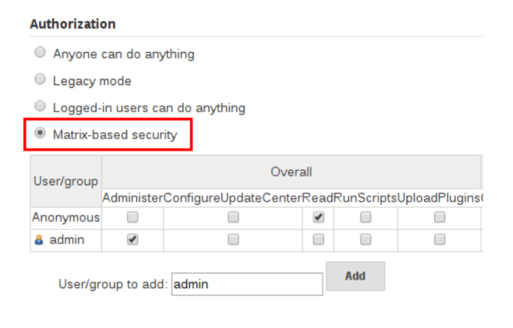

Slide 18
Markup Formatter
Jenkins allows user-input in a number of different configuration fields and text areas which can lead to users inadvertently, or maliciously, inserting unsafe HTML and/or JavaScript.
Using the Safe HTML Markup Formatter allows for users and administrators to inject useful and information HTML snippets into Project Descriptions and elsewhere.

Slide 19
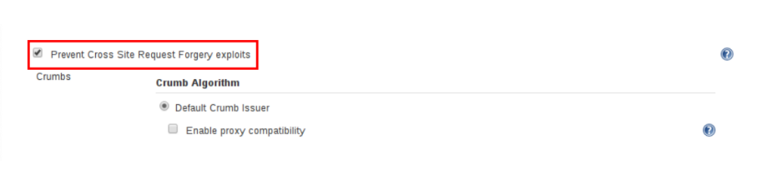
Cross Site Request Forgery
In the context of a Jenkins environment, a CSRF attack could allow an malicious actor to delete projects, alter builds, or modify Jenkins' system configuration. To guard against this class of vulnerabilities, CSRF protection has been enabled by default with all Jenkins versions since 2.0

Slide 20
Caveats
CSRF protection may result in challenges for more advanced usages of Jenkins
● Some Jenkins features, like the remote API, are more difficult to use when this option is enabled.
● Accessing Jenkins through a poorly-configured reverse proxy may result in the CSRF HTTP header being stripped from requests, resulting in protected actions failing.
● Out-dated plugins, not tested with CSRF protection enabled, may not properly function.

Slide 21
Agent/Master Access Control Conceptually, the Jenkins master and agents can be thought of as a cohesive system which happens to execute across multiple discrete processes and machines. This allows an agent to ask the master process for information available to it, for example, the contents of files, etc. For larger or mature Jenkins environments where a Jenkins administrator might enable agents provided by other teams or organizations, a flat agent/master trust model is insufficient

Slide 22
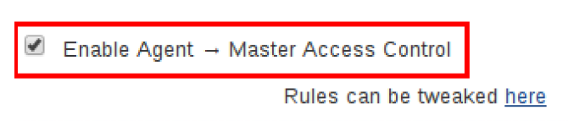
Agent/Master Access Control
Conceptually, the Jenkins master and agents can be thought of as a cohesive system which happens to execute across multiple discrete processes and machines. This allows an agent to ask the master process for information available to it, for example, the contents of files, etc.
For larger or mature Jenkins environments where a Jenkins administrator might enable agents provided by other teams or organizations, a flat agent/master trust model is insufficient.
The Agent/Master Access Control system was introduced to allow Jenkins administrators to add more granular access control definitions between the Jenkins master and the connected agents.

Slide 23
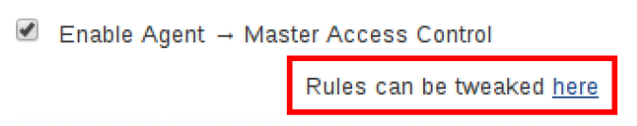
Customizing Access
For advanced users who may wish to allow certain access patterns from the agents to the Jenkins master, Jenkins allows administrators to create specific exemptions from the built-in access control rules.
By following the link highlighted above, an administrator may edit Commands and File Access Agent/Master access control rules.

Slide 24
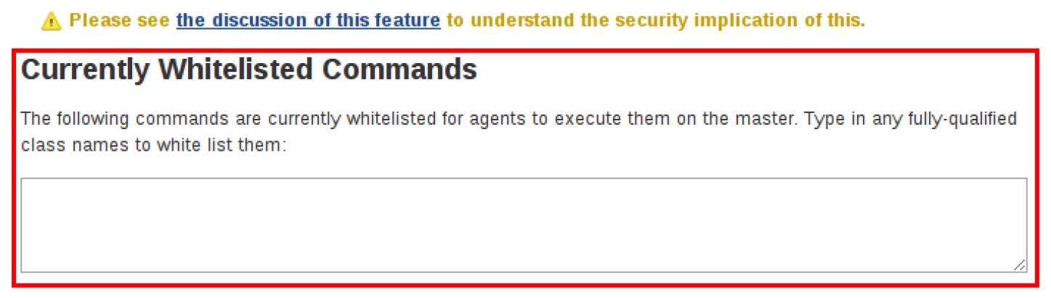
Commands
"Commands" in Jenkins and its plugins are identified by their fully-qualified class names.
The majority of these commands are intended to be executed on agents by a request of a master, but some of them are intended to be executed on a master by a request of an agent.
Plugins not yet updated for this subsystem may not classify which category each command falls into, such that when an agent requests that the master execute a command which is not explicitly allowed, Jenkins will err on the side of caution and refuse to execute the command.
In such cases, Jenkins administrators may "whitelist" certain commands as acceptable for execution on the master.

Slide 25

Advanced
Administrators may also whitelist classes by creating files with the .conf extension in the directory JENKINS_HOME/secrets/whitelisted-callables.d/.
The contents of these .conf files should list command names on separate lines.
The contents of all the .conf files in the directory will be read by Jenkins and combined to create a default.conf file in the directory which lists all known safe command. The default.conf file will be re-written each time Jenkins boots.
Jenkins also manages a file named gui.conf, in the whitelisted-callables.d directory, where commands added via the web UI are written.

Slide 26
File Access Rules
The File Access Rules are used to validate file access requests made from agents to the master. Each File Access Rule is a triplet which must contain each of the following elements:
allow/deny
read
write
mkdirs
create
operation
delete
stat
all
file path
<JENKINS_HOME>
<BUILDDIR>
<BUILDID>

Slide 27
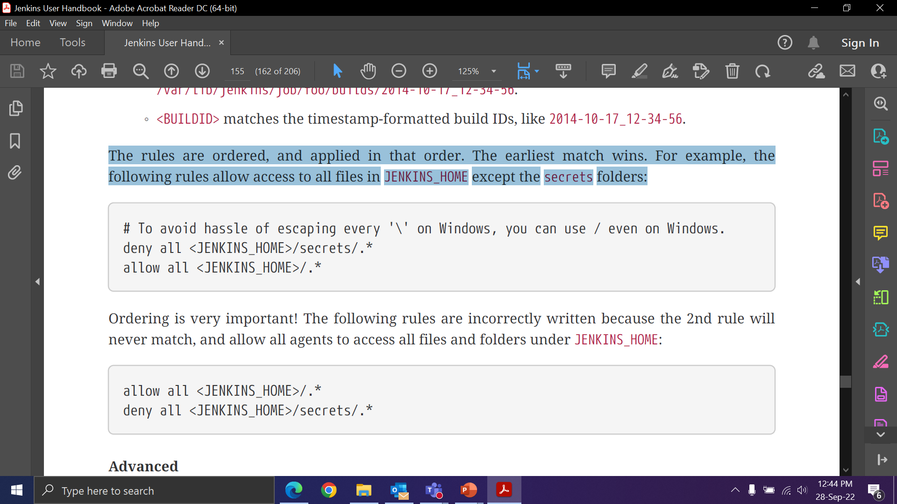
The rules are ordered, and applied in that order. The earliest match wins. For example, the following rules allow access to all files in JENKINS_HOME except the secrets folders:
Ordering is very important! The following rules are incorrectly written because the 2nd rule will never match, and allow all agents to access all files and folders under JENKINS_HOME:

Slide 28
Advanced
Administrators may also add File Access Rules by creating files with the .conf. extension in the directory JENKINS_HOME/secrets/filepath-filters.d/.
Jenkins itself generates the 30-default.conf file on boot in this directory which contains defaults considered the best balance between compatibility and security by the Jenkins project.
On each boot, Jenkins will read all .conf files in the filepath-filters.d directory in alphabetical order, therefore it is good practice to name files in a manner which indicates their load order.
Jenkins also manages 50-gui.conf, in the filepath-filters/ directory, where File Access Rules added via the web UI are written.

Slide 29
Disabling
While it is not recommended, if all agents in a Jenkins environment can be considered "trusted" to the same degree that the master is trusted, the Agent/Master Access Control feature may be disabled.
Additionally, all the users in the Jenkins environment should have the same level of access to all configured projects.
An administrator can disable Agent/Master Access Control in the web UI by un-checking the box on the Configure Global Security page.
Alternatively, an administrator may create a file in JENKINS_HOME/secrets named slave-to-master-security-kill-switch with the contents of true and restart Jenkins.

Slide 30
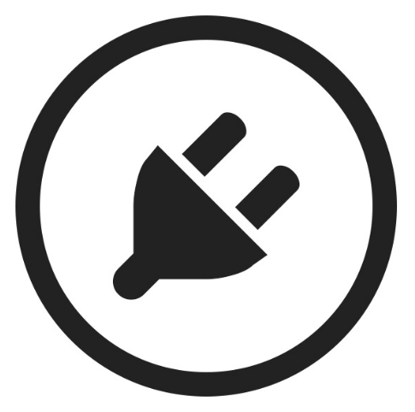
Managing Plugins
Plugins are the primary means of enhancing the functionality of a Jenkins environment to suit organization- or user-specific needs.
There are over a thousand different plugins which can be installed on a Jenkins master and to integrate various build tools, cloud providers, analysis tools, and much more.
Plugins can be automatically downloaded, with their dependencies, from the Update Center.

Slide 31
Installing a Plugin
Jenkins provides a couple of different methods for installing plugins on the master:
Using the "Plugin Manager" in the web UI.
Using the Jenkins CLI install-plugin command.
Each approach will result in the plugin being loaded by Jenkins but may require different levels of access and trade-offs in order to use.
The two approaches require that the Jenkins master be able to download meta-data from an Update Center, whether the primary Update Center operated by the Jenkins project, or a custom Update Center.
The plugins are packaged as self-contained .hpi files, which have all the necessary code, images, and other resources which the plugin needs to operate successfully.

Slide 32
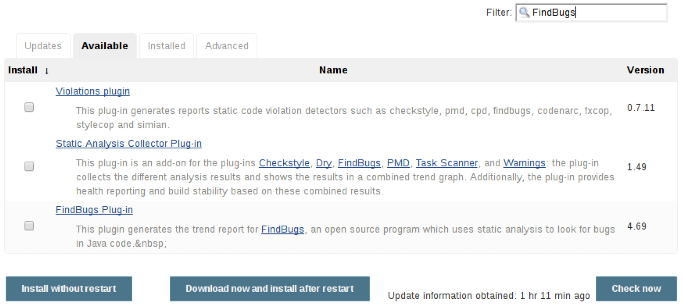
From the webUI
The simplest and most common way of installing plugins is through the Manage Jenkins > Manage Plugins view, available to administrators of a Jenkins environment.
Under the Available tab, plugins available for download from the configured Update Center can be searched and considered:

Slide 33
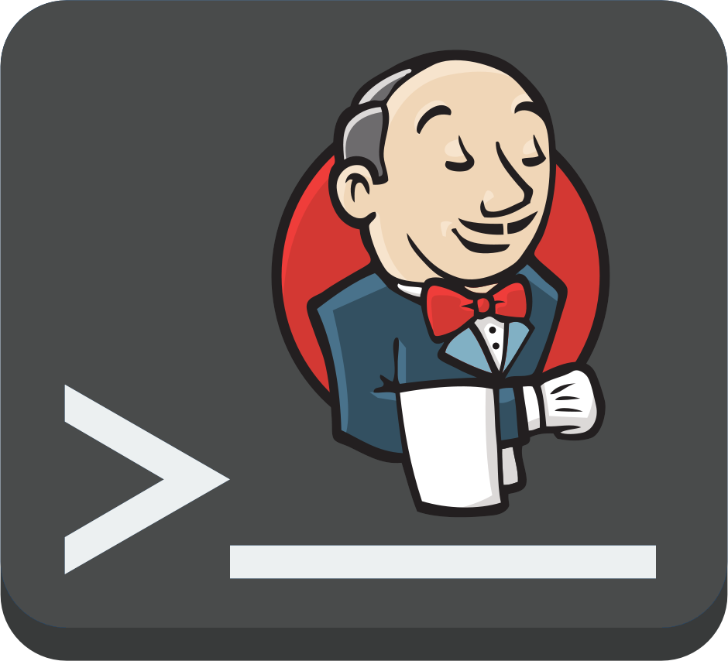
Using the Jenkins CLI
Administrators may also use the Jenkins CLI which provides a command to install plugins.
Scripts to manage Jenkins environments, or configuration management code, may need to install plugins without direct user interaction in the web UI.
The Jenkins CLI allows a command line user or automation tool to download a plugin and its dependencies.

Slide 34
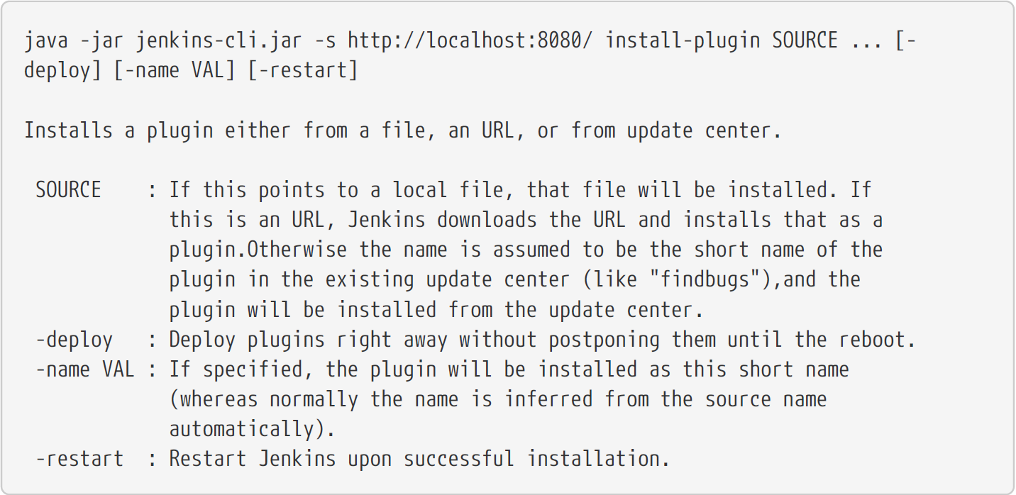

Slide 35
Advanced Installation
The Update Center only allows the installation of the most recently released version of a plugin. In cases where an older release of the plugin is desired, a Jenkins administrator can download an older .hpi archive and manually install that on the Jenkins master.
From the webUI
Assuming a .hpi file has been downloaded, a logged-in Jenkins administrator may upload the file
from within the web UI:
Navigate to the Manage Jenkins > Manage Plugins page in the web UI.
Click on the Advanced tab.
Choose the .hpi file under the Upload Plugin section.
Upload the plugin file.

Slide 36
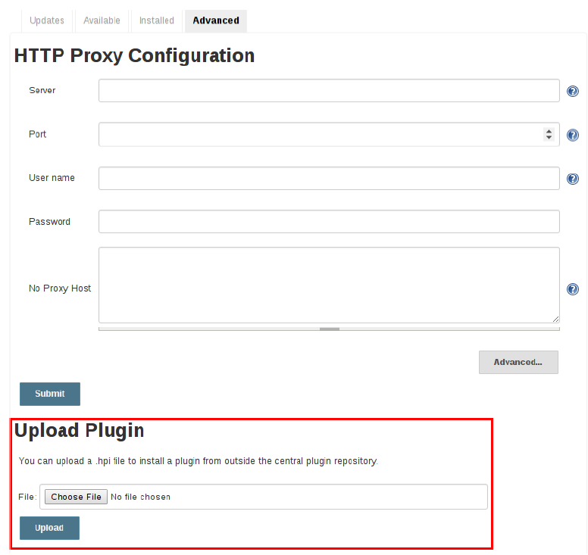

Slide 37
On the master
Assuming a .hpi file has been explicitly downloaded by a systems administrator, the administrator can manually place the .hpi file in a specific location on the file system.
Copy the downloaded .hpi` file into the JENKINS_HOME/plugins directory on the Jenkins master (for example, on Debian systems JENKINS_HOME is generally /var/lib/jenkins).
The master will need to be restarted before the plugin is loaded and made available in the Jenkins environment.

Slide 38
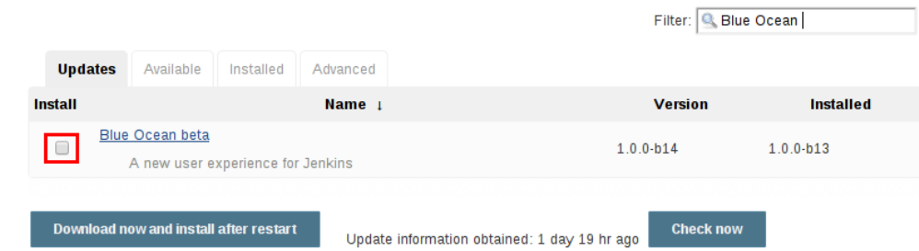
Updating a plugin
Updates are listed in the Updates tab of the Manage Plugins page.
This can be installed by checking the checkboxes of the desired plugin updates and clicking the Download now and install after restart button.
By default, the Jenkins master will check for updates from the Update Center once every 24 hours.

Slide 39
Removing a plugin
When a plugin is no longer used in a Jenkins environment, it is prudent to remove the plugin from the Jenkins master.
This provides several benefits such as
reducing memory overhead at boot or runtime.
reducing configuration options in the web UI.
removing the potential for future conflicts with new plugin updates.

Slide 40
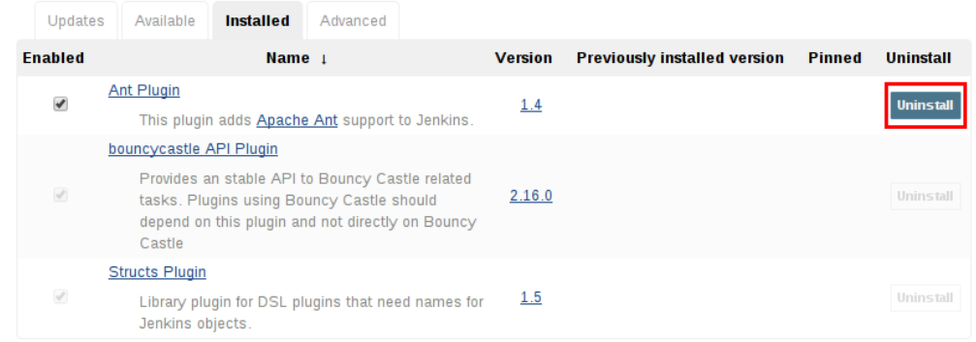
Uninstalling a plugin
The simplest way to uninstall a plugin is to navigate to the Installed tab on the Manage Plugins page. From there, Jenkins will automatically determine which plugins are safe to uninstall, those which are not dependencies of other plugins, and present a button for doing so.
A plugin may also be uninstalled by removing the corresponding .hpi file from the JENKINS_HOME/plugins directory on the master. The plugin will continue to function until the master has been restarted.

Slide 41
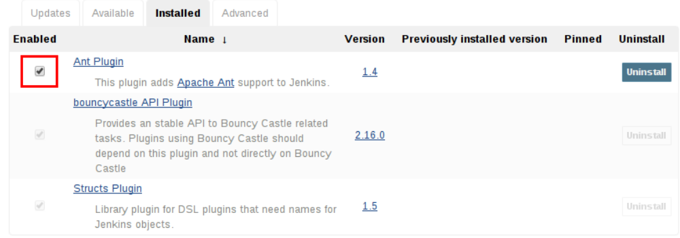
Disabling a plugin
Disabling a plugin is a softer way to retire a plugin.
Jenkins will continue to recognize that the plugin is installed, but it will not start the plugin, and no extensions contributed from this plugin will be visible.
A Jenkins administrator may disable a plugin by unchecking the box on the Installed tab of the Manage Plugins page.

Slide 42

Pinned plugins
The notion of pinned plugins applies to plugins that are bundled with Jenkins 1.x, such as the plugin: matrix-auth[Matrix Authorization plugin].
By default, whenever Jenkins is upgraded, its bundled plugins overwrite the versions of the plugins that are currently installed in JENKINS_HOME.
when a bundled plugin has been manually updated, Jenkins will mark that plugin as pinned to the particular version.
On the file system, Jenkins creates an empty file called JENKINS_HOME/plugins/PLUGIN_NAME.hpi.pinned to indicate the pinning.
This file can also be manually created/deleted to control the pinning behavior.

Slide 43

Jenkins CLI
Jenkins has a built-in command line interface that allows users and administrators to access Jenkins from a script or shell environment. This can be convenient for scripting of routine tasks, bulk updates, troubleshooting, and more.
The command line interface can be accessed over SSH or with the Jenkins CLI client, a .jar file distributed with Jenkins.

Slide 44
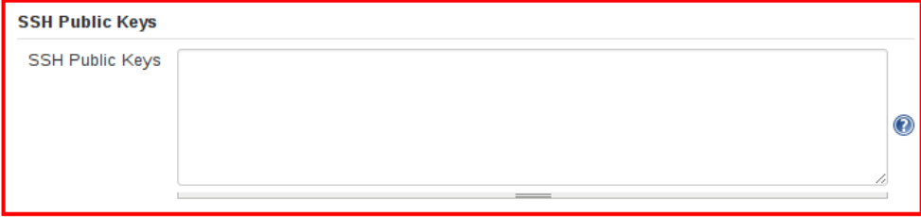
Using the CLI over SSH
In a new Jenkins installation, the SSH service is disabled by default. Administrators may choose to set a specific port or ask Jenkins to pick a random port in the Configure Global Security page.
In order to determine the randomly assigned SSH port, inspect the headers returned on a Jenkins URL. With the random SSH port and Authentication configured, any modern SSH client may securely execute CLI commands.
Whichever user used for authentication with the Jenkins master must have the Overall/Read permission in order to access the CLI.
In order to add an SSH public key for the appropriate user, navigate to JENKINS_URL/user/USERNAME/configure and paste an SSH public key into the appropriate text area.

Slide 45
Thank
YOU

